Slide 1


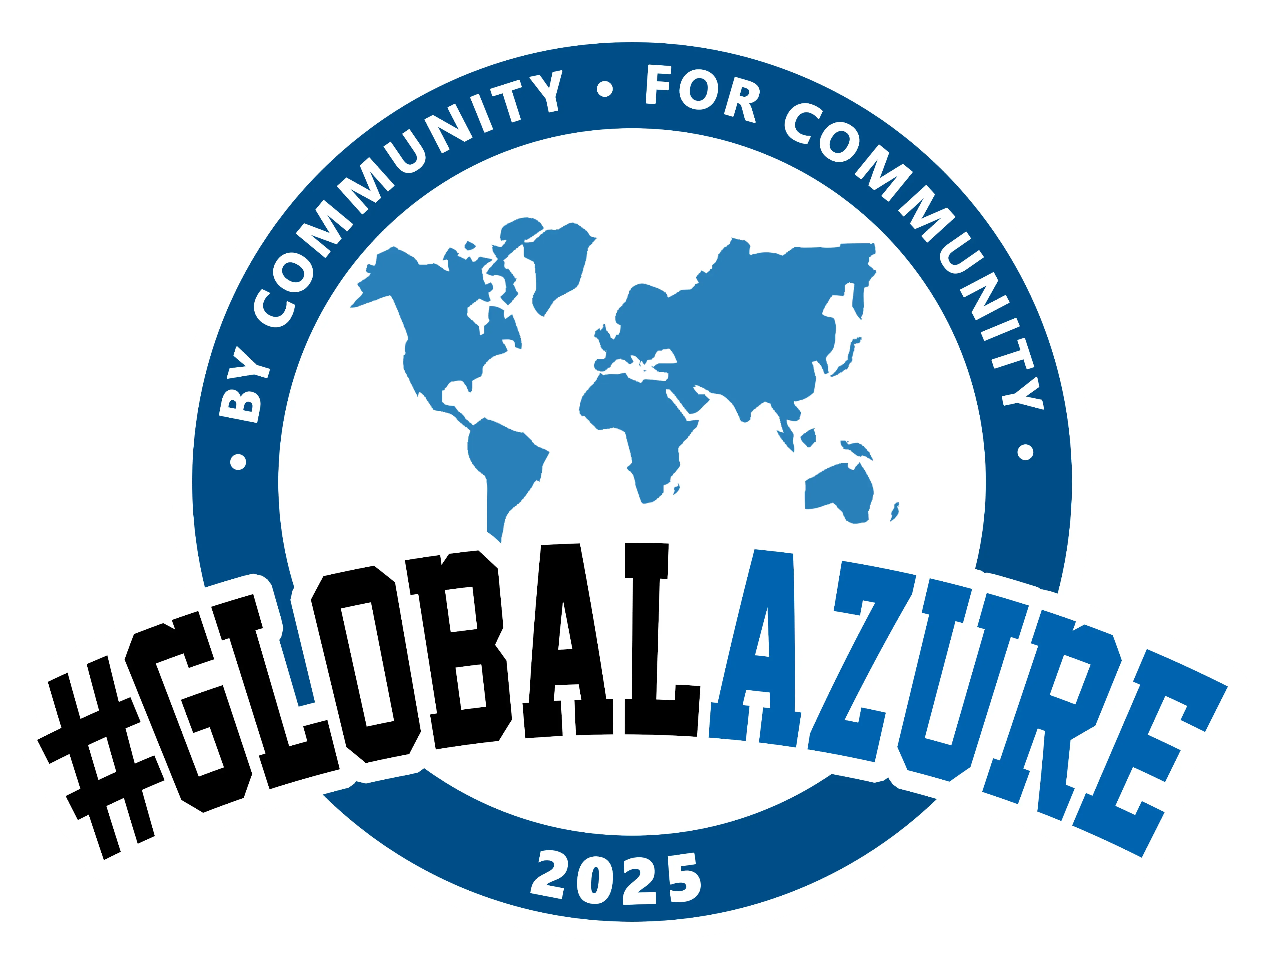
Beer-Driven Development
Bridging the gap between business and tech with bdd and living documentation
John Pourdanis • Lead QA Engineer @Vimachem

Slide 2
Agenda
• Introduction: The Business & Tech Gap
• Business-Driven Development and Living Documentation
• Live Demonstration
• Pros & Cons of BDD
• Q&A Session

Slide 3
The Business & Tech Gap
• Align software dev with business goals
• A process of requirement, gathering and analysis
• Everyone should now how the system should behave.
• Keeps everyone on the same page

Slide 4
What is BDD?
• A collaborative software development practice
• Gherkin syntax for human-readable tests
• Tools like SpecFlow or Reqnroll for automation
• Better communication, clarity, and test coverage

Slide 5
Example of Gherkin feature files
From this:
As a user,
I want to search for the weather at https://openweathermap.org/
So that I can get the results for the current weather for a specific city.
To this:
Scenario: Search for current weather in a specific city
Given I am on the OpenWeatherMap homepage
When I enter "Athens" into the search bar
And I click the search button
Then I should see the current weather for "Athens"

Slide 6
💡Feature files on Test Reports aka Living Doc
• Write tests steps for each Given,When,Then
• Run tests on a pipeline
• Create a Test Report
• Publish the html report (host it somewhere)
• Bonus: Add attachments

Slide 7
Live Demo: Running BDD Tests
• Existing Integration Tests
• BDD to Integration and E2E Tests
• Allure Reports
• Azure Pipelines & Github Actions

Slide 8
Pros
• Early clarity and fewer bugs: BDD uncovers hidden requirements early, reducing costly rework and ensuring cleaner delivery.
• Improved communication: Using domain-specific language bridges the gap between business and technical teams, avoiding misunderstandings.
• Living and Evolving Documentation: In traditional approaches, documentation becomes outdated quickly. Living Doc helps members onboard faster, make audits etc.
• Shift-left testing: Testers are involved from the start, enhancing quality and identifying issues much earlier in the project lifecycle.

Slide 9
Cons
• High Initial Investment: Setting up BDD frameworks, writing scenarios, and training the team takes time and effort upfront, which can slow early project phases.
• Communication Dependency: BDD heavily relies on strong communication among team members; poor collaboration can lead to vague or incorrect scenarios.
• Maintenance Overhead: As systems grow, keeping feature files, scenarios, and automation code up-to-date becomes a significant maintenance task.
• Not Ideal for Every Project: For very small, short-term projects, the overhead of BDD might outweigh its benefits compared to simpler development practices.

Slide 10
Wait. Where is the beer?
• Deal with 2 different worlds.
• Change the mindset of your team.
• Sharing food is always a great idea!

Slide 11




Questions?
Let’s chat! Open floor for discussion and insights.

Slide 12
Conclusion & Takeaways
• BDD improves collaboration and clarity.
• Living docs share the status on each release.
• Change the mindset of the team.
• Not an easy task, needs a lot of beer.

Slide 13

Thank You!
📧 www.jpourdanis.com
🐙 GitHub: github.com/jpourdanis
🔗 LinkedIn: John Pourdanis
Let’s drink a beer together!

